Slide 1
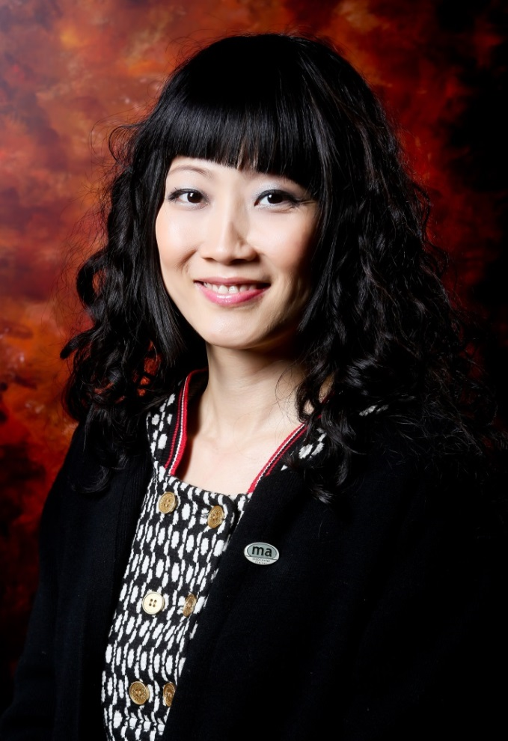
網路中心開拓無限盈利潛力
The Profitable Possibilities with WebCenters
Frances Siu
專業經理級 Professional Coordinator
四個佣金週期共賺取HK$34,500
HK$34,500 in 4 Commission weeks
本簡報中提到的收入等級純屬舉例說明，無意代表美安香港超連鎖店主的一般收入，也無意表示任何超連鎖店主皆可賺取同等收入。美安香港超連鎖店主的成功與否，取決於其在發展事業時的努力、才能與投入程度。The income levels mentioned in the following presentation are for illustration purposes only. They are not intended to represent the income of a typical Market Hong Kong UnFranchise Owner, nor are they intended to represent that any given Independent UnFranchise Owner will earn income in that amount. The success of any Market Hong Kong Independent UnFranchise Owner will depend upon the amount of hard work, talent, and dedication which he or she devotes to building his or her Market Hong Kong Business.

Slide 2
Earn now while building for the future
與網路中心「賺取」更多未來
Earn Now, Build for the Future with maWebCenters
maWebcenters
Notes:
JF

Slide 3
1000 % 零售利潤 1000% Retail Profit
生意商機
Business Opportunities

Slide 4
現在就開始起步: 零售利潤 Earn now: retail profit
有多少人投入金錢來參加今天這場大會?
How many people invested money to be here today?
有多少人知道，有人因為沒有足夠的費用，而錯過這場大會?
How many people know someone who missed this event because of cost?
網站平均零售利潤是$7,000
The Average Website Retail Profit is $7,000

Slide 5
簡單5步驟帶領你邁向成功 5 Simple steps for success
如何在接下來的30天內，銷售出你的第一個網站:
How to sell your 1st website in the next 30 days:
了解益處
規畫 & 找出一個合格的名單
與你的潛在對象往來
借力專業團隊
持之以恆、簡單事情重複做
Understand the Benefits
Craft & Qualify a Quality Nameslist
Engage Your Prospects
Leverage Teams of Professionals
Rinse & Repeat
Notes:
JF

Slide 6
步驟 1: 了解益處 Step 1: Understand the benefits
這不需要了解技術
我們只需要了解，我們可以如何協助他人!
It’s not about understanding the technology.
It’s about understanding How You Can Help Someone!
想想看，你為什麼會推薦:
一場電影?
一家餐廳?
一個服務?
很簡單!
你喜歡它
你不必是內行人， 也可以做內行事
第三人見證
你想幫助他人
SIMPLE!
You liked it
You don’t know the ins/outs of that industry
3rd Party Testimonial
You want to help someone
Think about WHY
you recommend anything:
A movie?
A restaurant?
A service?
Notes:
JF

Slide 7
步驟 1: 了解益處 Step 1: Understand the benefits
增加他們的利潤
減少他們的費用支出
增加客戶滿意度
在2014年，以最有效的方式，來行銷你自己!
簡化他們的線上行銷策略
Increase their Revenues
Decrease their Expenses
Increase Customer Satisfaction
Participate in the Most Effective Way to Market Yourself in 2014!
Simplify their Online Marketing Strategy
We Help Businesses
Notes:
SR

Slide 8
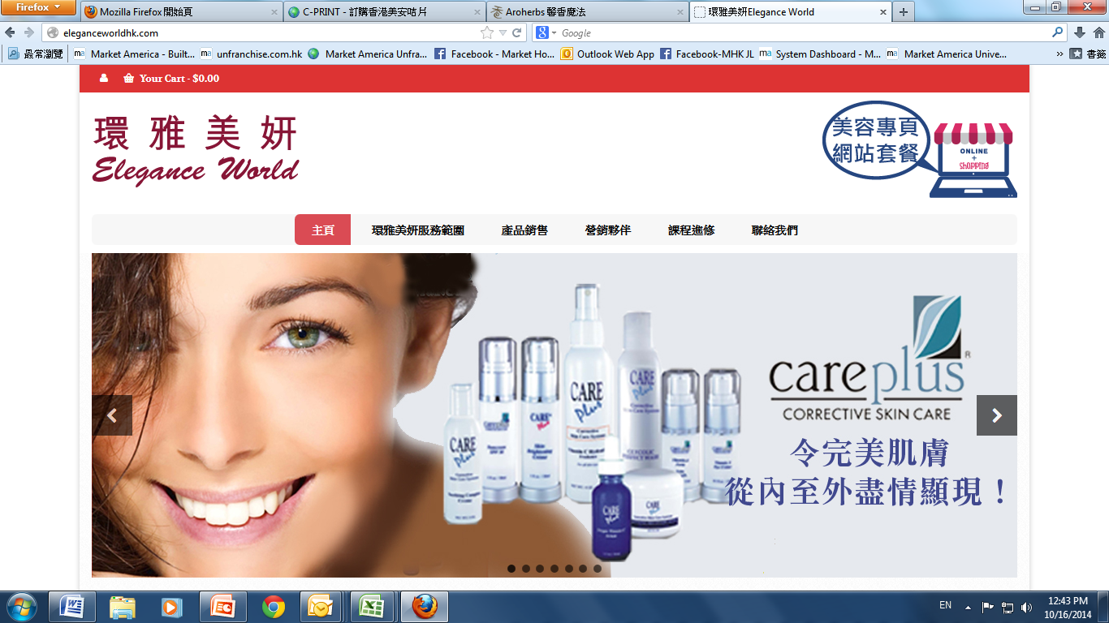
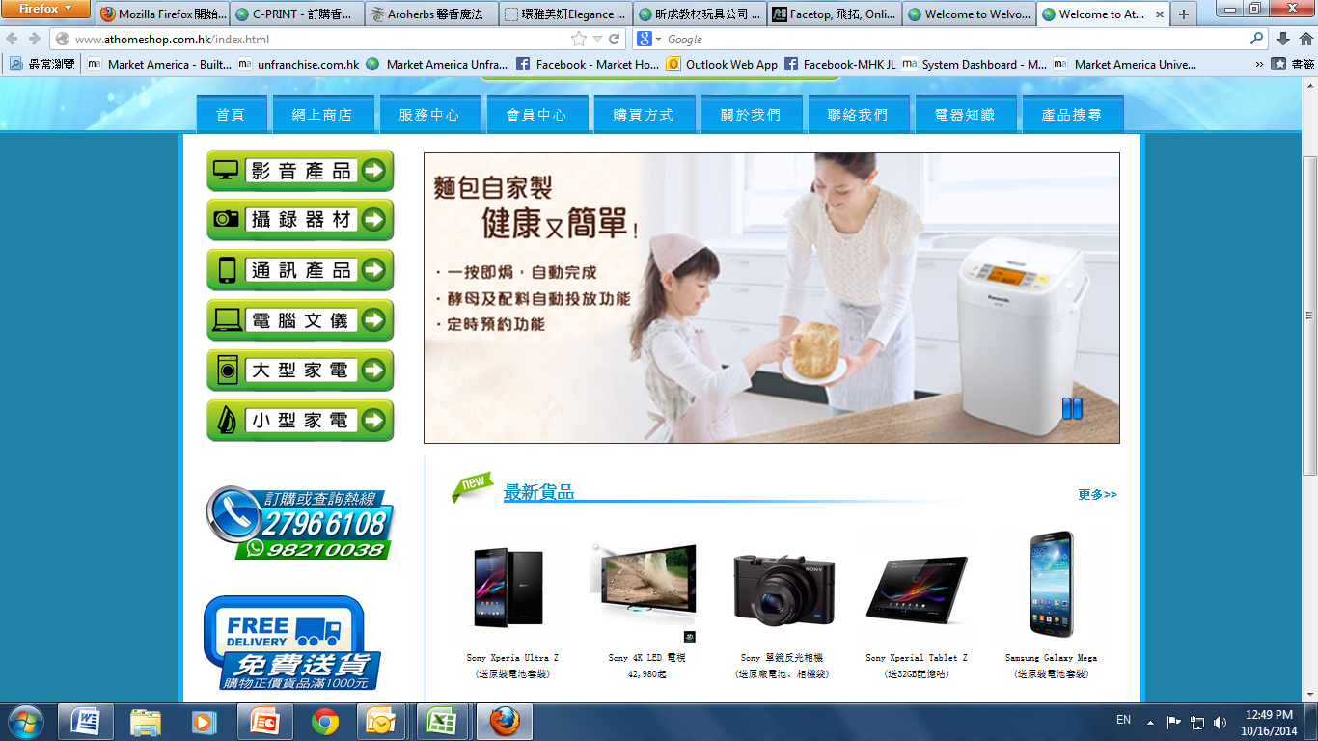
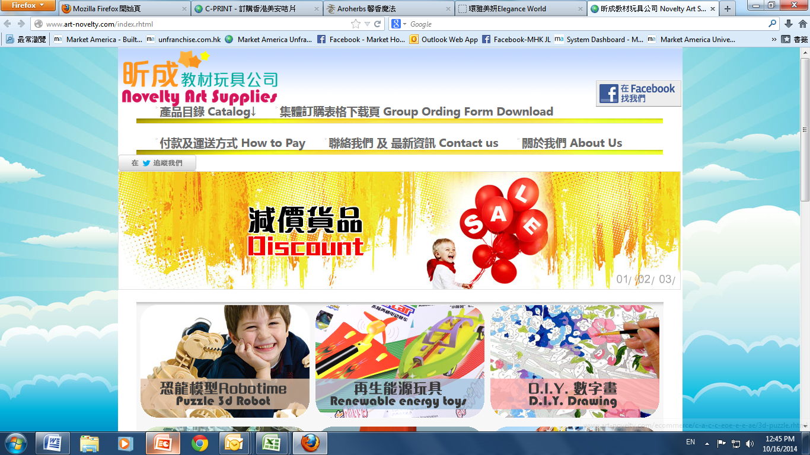
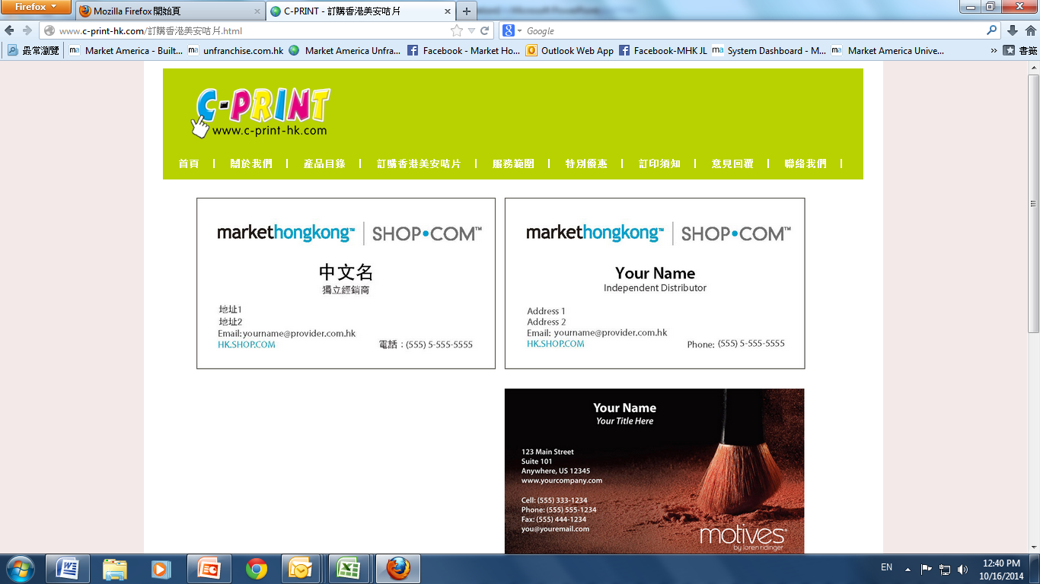
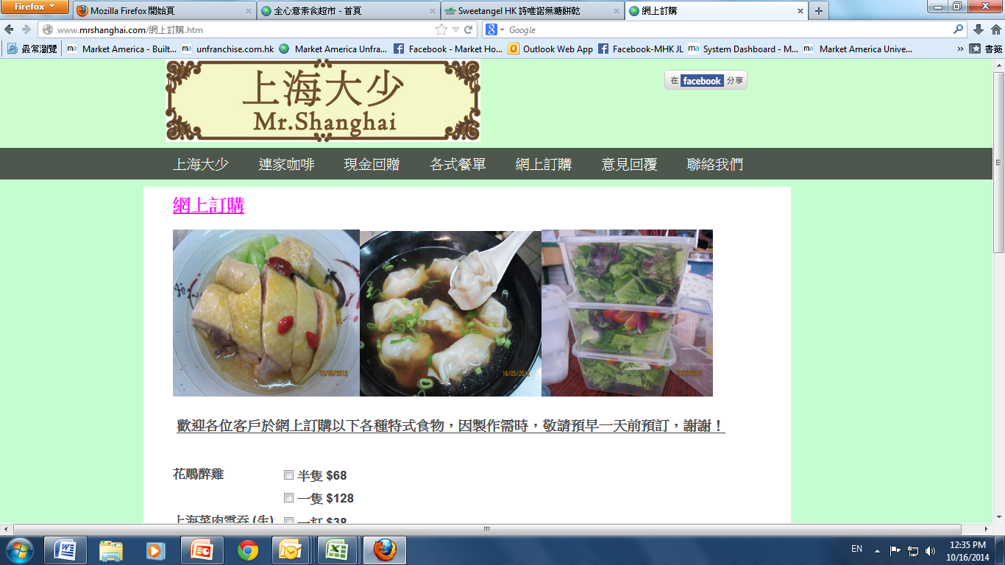
「我們的網站，持續為我們的生意帶來訂單。我們特別喜愛社交媒體功能！ 在聯絡客戶的開銷上，為我們節省大筆金額，甚至達到更好的效果 – 非常容易管理！」
“Having our website has increased our order out business substantially. We especially love the new email marketing system! Saved us money from having to have the service with Constant Contact and better than that – this is simpler to manage!”
Notes:
SR

Slide 9
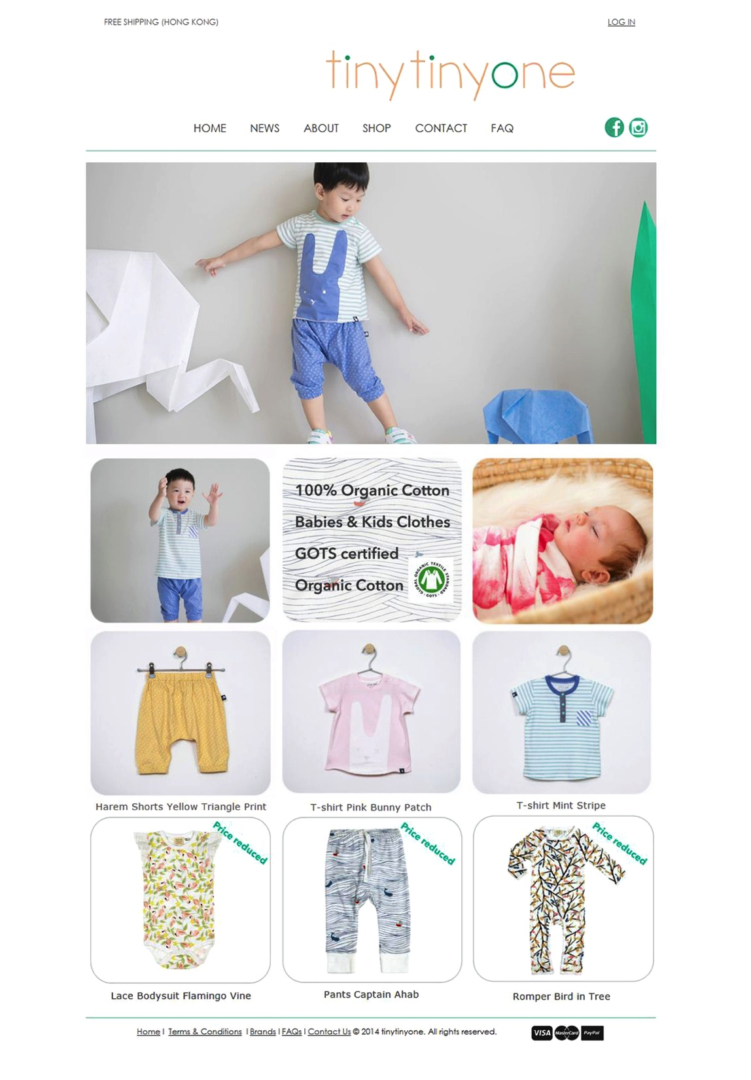
「過去只把網站當作一張DM，依賴店內客戶的口碑行銷帶來有限的生意。
現在我們不只是有了一個更漂亮的網站，可以精準的呈現產品質感，加上有行銷工具可以使用。在我們上線的第一個月，就帶來6位數的線上銷售金額。 」
“During our first year online with our old site, we did no sales and our design was so horrible that it probably negatively affected our business. Not only do we have a more beautiful website that accurately represents the quality of our business but since it is coupled with several marketing tools, we have cleared six figures in online sales during our first year of selling online. “
Notes:
SR

Slide 10
步驟2: 規畫、找出一個合格的名單 Step 2: craft & qualify a nameslist
你可以在 unfranchisetraining.com 下載網路中心起步指南
Available in the WebCenters Getting Started Guide on www.mawc411.com
Accountants
Restaurants
Contractors
Lawyers
Gyms
Salons
Car Detailers
Dentists
Doctors
Landscapers
Retail Shops
Organizations
Churches
More!
是否為業主？ Owns a Business? | 在一家企業工作? Works for a Business? | 有業務來往？ You Do Business with? | 交友廣泛？ Is Well Connected? | 需要進一步了解的内容 You want to get to know?
會計師
餐館
承包商
律師
健身房
美容院
汽車修理工
牙醫
醫生
園藝工
零售商店
社團
教會
以及更多!
Notes:
SR

Slide 11
步驟 3:與你的潛在對象往來 Step 3: Engage your prospects
這是一個簡單的對話行銷:
1.問候 / 你好嗎?
2.生意/工作如何?
3.你的網站經營得如何?
It’s Simple Conversational Marketing:
1.Social / How are You?
2.How’s Business / Work?
3.How’s Your Website?
與人交談 In Person
利用社群媒體
On social media
交換資訊 & 分享你的網站
Exchange information & Share your website
交換資訊 & 分享你的網站
Exchange information & Share your website
Notes:
JF

Slide 12
挖掘資料Find the Information
請記得，發問問題的人，可以掌控整個對話主題!
詢問關於他們的網站或線上策略的明確問題
找出明確的原因
Remember, the people who ask questions, control the entire conversation !
Ask clear questions about their website or online strategy
Find a clear reason
你會發現，他們的回應不外乎以下類別:
You will find that their responses confined to the following categories:
現在的網站
很棒
The website is great
現在的網站
糟透了The website is terrible
他們現在
沒有網站
They don’t have website
他們正在架設
They are creating a website
他們目前只用
社群媒體
The have social media accounts only
無論他們的回應是什麼: 你只要多問幾個問題，就可以找出更多明確的需求!
No matter what their response was:
Just ask a few more questions, you can find out their clearly needs more!
Notes:
Ask good questions!
Much easier to solve a problem than it is to Sell a website with just a tiny bit of information

Slide 13
步驟 4: 借力我們的團隊 Step 4: Leverage our teams
當你已經找出一些地方，是你可以幫上忙的… When you have identified some areas where you can help…
就是時候，提供一個解決方案: 會談提及產品專員!
It’s time to offer a solution: THE APPOINTMENT Edify the Product Specialist!
「你知道，這不是我的專長，但跟我合作的公司有一個部門，可以協助你的企業，有效利用網際網路。我很樂意幫你安排一次會談，讓一位產品專員以30分鐘左右向你介紹我們的科技，看看是否對你和你的企業有幫助。你通常是早上還是下午有空？」
“You know, it’s not an area that I specialize in, but the company I work with has an entire division that helps businesses like yours effectively leverage the Internet.
I would be happy to set up an appointment to have one of the Product Specialists take about 30 minutes to show you the technology to see if it has value to you and your business. What typically works best for you mornings or afternoons?”
Notes:
JF

Slide 14
步驟 4: 借力我們的團隊 Step 4: Leverage our teams
我們的專業團隊 你所要做的，就是加入我們!
Our Teams of Professionals
are here for you and your prospects!
你 邀約會談
You: Schedule the appointment
產品專員 Product Specialists進行會談 / 為你銷售網站!
技術支援
為你的客戶處理所有技術問題!
Technical Support
Handle all the technical problems for your customers!
你 賺取230 BV零售利潤及來自活躍客戶的每月30 BV，並做一名稱職的「顧客經理」
Earn Retail Profit and 230 BV , earn 30 BV/ Month from an active customer, to be a Customer Manager
Notes:
TRAINER’S NOTES:
Simple Sales Recap
Keep it simple!
Leverage the teams of professionals to do all the heavy lifting for you
You can give tips for being a customer manager – what do you do with your clients? - Call to see how the appointment went - Make sure your clients have accurate contact information for tech support - Check in every once in a while

Slide 15
步驟 5: 持之以恆、簡單事情重複做 Step 5: Rinse & repeat
成功，是來自於，每天重複的付出一些，就能匯集創造一個美好的成果
Success is the result of small efforts, repeated daily that compound to create big results
網路中心經營者的成功秘訣
每天與1位網站潛在客戶對談
每天與2位超連鎖™事業潛在對象對談
每天安排1個會談
保持負責任的態度 加入網路中心積分競賽活動
WCO Daily Formula for Success
Talk to 1 website prospect each day
Talk to 2 UFO prospects each day
Schedule 1 appointment each day
Stay Accountable by Join
the #weBVolume Contest!
Notes:
SR

Slide 16
為什麼?Why?
每天連絡1個網站客戶=每周5個
每周5個客戶=每周可達成1-2個網站會談
每周達成1-2個網站會談=1個月有4-8個會談
事實: 每3個合格的會談，可以銷售出1個網站 每月4-8次的網站會談 = 有機會每月銷售1-3個網站!
1 website contact a day = 5 per week
5 per week = 1-2 website apts.
1-2 web apts. per week = 4-8 per month
FACT: 1 in 3 qualified apts. ends in a sale 4-8 apts./month = Potential 1-3 sales per month!

Slide 17
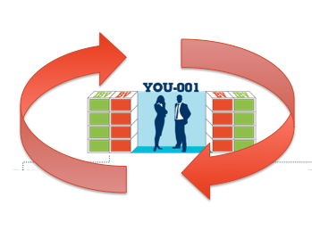
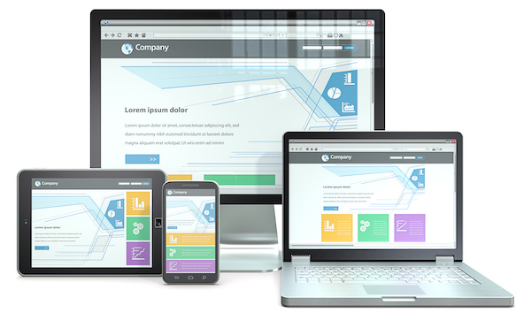
建立你的未來: 持續性的業績點數 Build for the future: ongoing BV
每個網站產生 230 BV
Each website sold generates 230 BV
每位活躍客戶
每月產生 30 BV
Each active client generates 30 BV / Month
現在，你可以從設計套裝，賺取額外的BV
Now you can earn additional BV on Design!
Notes:
JF

Slide 18
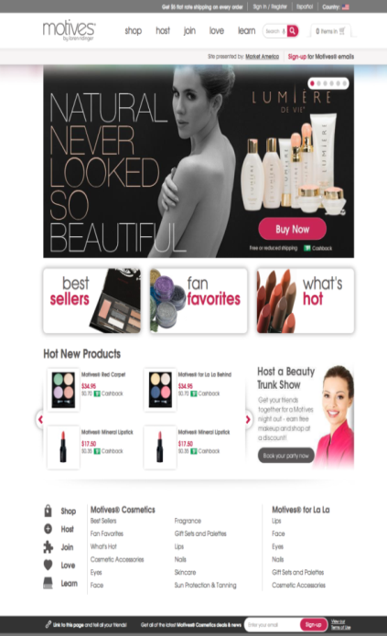
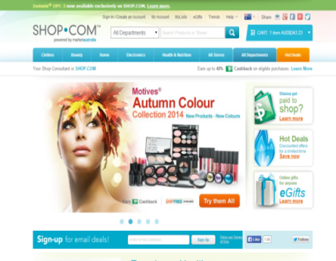
建立你的未來: 招募 Build for the future: prospecting
我們的顧客都是小型企業主
Our Customers are Small Business Owners
中小企業主 = 企業家/潛在的超連鎖™店主對象
SMB Owners = Entrepreneurs / UFO Prospects
我們幫助企業主，解決管理/費用問題
Help business owners with their overhead / expenses
以其他美安產品，
建立顧客購物類別
Build share of customer with other ma products
Notes:
JF

Slide 19
現在就開始起步: 零售利潤 Earn now: retail profit
如果平均利潤是$1,000 , 你所要做的只是，將你的目標總金額，除以$1,000，取得一個約略預算，看看應該銷售幾個網站
你可以將這個方式，應用在任何一個固定費用的目標
You can apply this to any of your fixed-cost goals
If the average profit is $1,000 , all you have to do is take the total cost of your goal and divide it by $1,000 to get an estimate for approx. how many website sales you need to sell
比如: 家庭旅遊: Ex: Family Vacation: $5,000 固定費用Fixed Cost Goal $5,000 平均零售利潤Average Retail Profit $1,000
= 5 個網站銷售，就可以支付你的旅費!
= 5 Website Sales to cover the cost of the vacation!
Notes:
JF

Slide 20
開始進行訓練課程Get trained
更多即將到來的訓練，
23/11 All star training
請立即登入NMTSS查詢
More trainings is yet to come,
23/11 All star training
Visit NMTSS to know more
Notes:
JF

Slide 21
開始之前…你必須擁有一個網路中心 You need a WebCenter first
大會優惠LS2014 Promotion
網路中心: WebCenter: $3237 / 300 BV
本周末限定
This weekend only.
現在，請立即至網路中心攤位，開通你的網路中心! Come to the WebCenter Booth and get started today!
✕
* 網路中心管理費仍需按月收取

